Slide 1
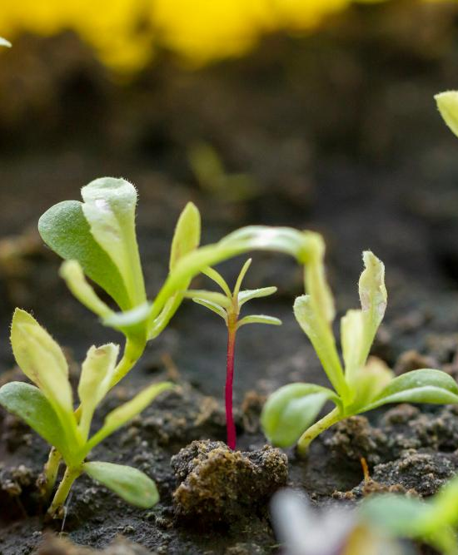
Smart Farmer Assistance Application
A Comprehensive Farm Management
Presented by :
Samian Rashid
Nesar Ahmed
Md Hasibul Hossain
Rayanul Kader Chowdhury Abid

Slide 2
Table of contents
01
02
03
04
05
06
Introduction
Motivation
Features
Methodology
Outputs
Limitation & Future Work

Slide 3
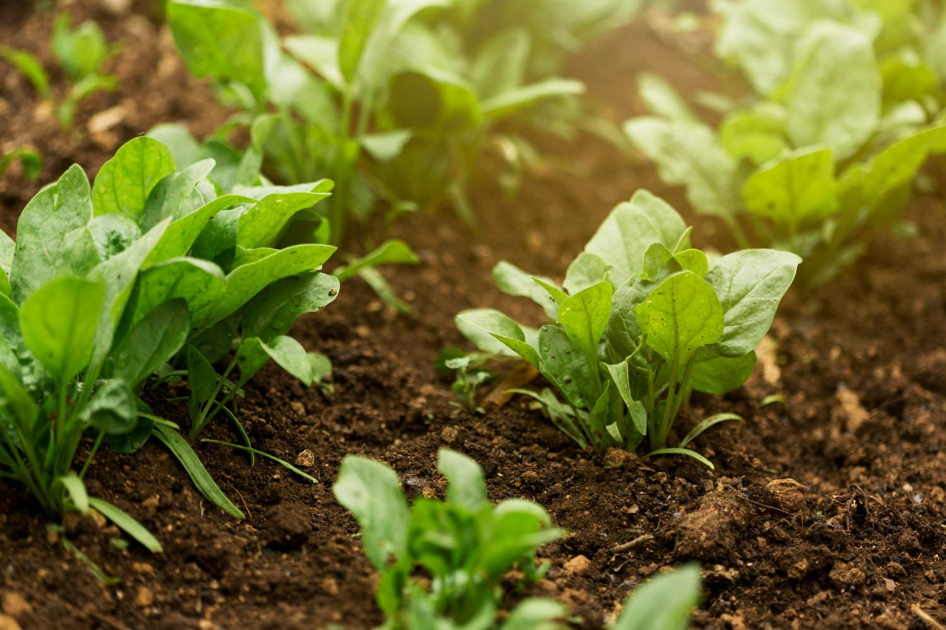
01
Introduction
Smart Farmer Assistance is an innovative system designed to modernize and simplify farm management. It integrates various features such as crop monitoring, livestock management, silo storage, equipment tracking, and real-time weather updates. Our platform provides farmers with a user-friendly interface to streamline their operations and make informed decisions, enhancing productivity and efficiency in agricultural practices.

Slide 4
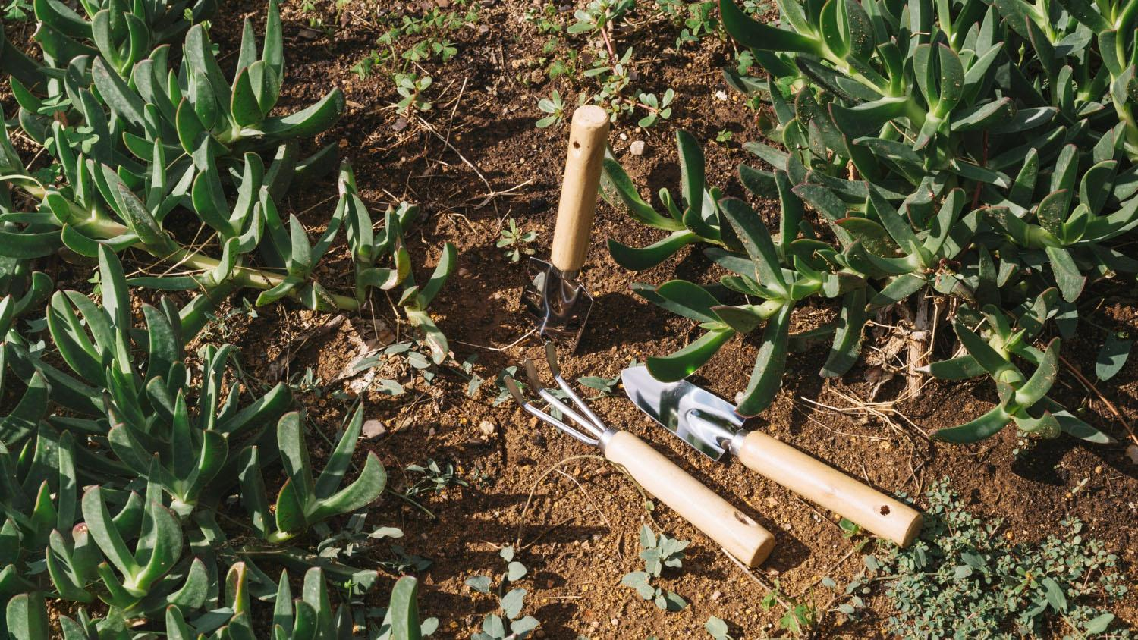
02
Motivation
We were inspired by the need to modernize farm management and reduce inefficiencies. Farmers often face challenges in managing multiple tasks and data sources. Our motivation is to develop a system that integrates these tasks, improves decision-making, and promotes sustainable farming practices.
“Innovation is the ability to see change as an opportunity , not a threat”

Slide 5

03
Features
Features of
Smart Farmer Assistance Application
Livestock Management
Silo Management
Crop Management
Agroforestry Management
Equipment Tracking
Weather Data Integration
Email
Notices
User Approval

Slide 6

04
Methodology
Planning and Requirement analysis
Software Architecture and Database Design
Construction of Software
Testing and Debugging

Slide 7
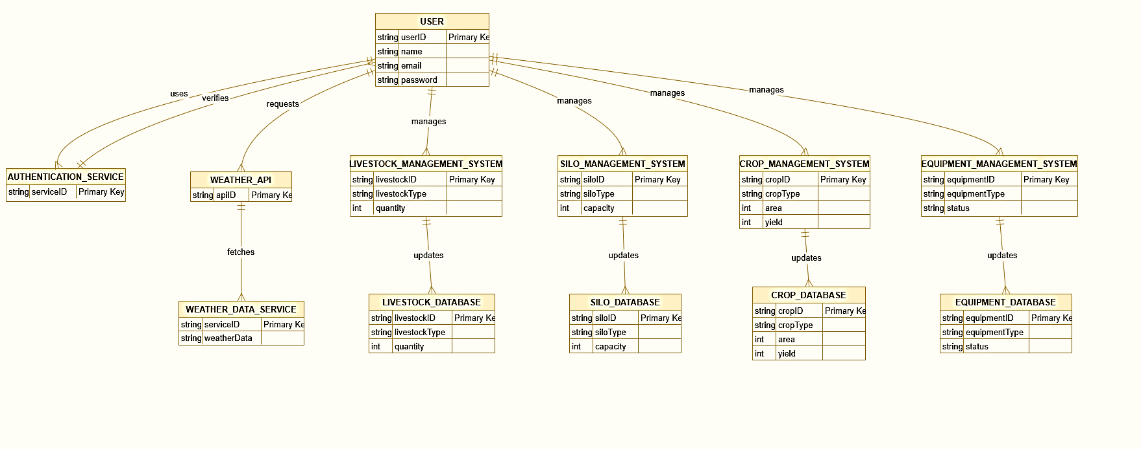
Database Design

Slide 8
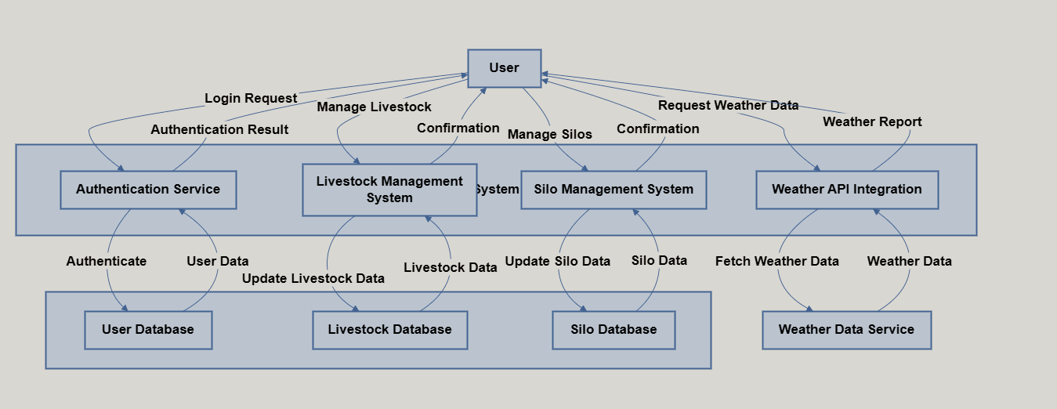
Workflow

Slide 9
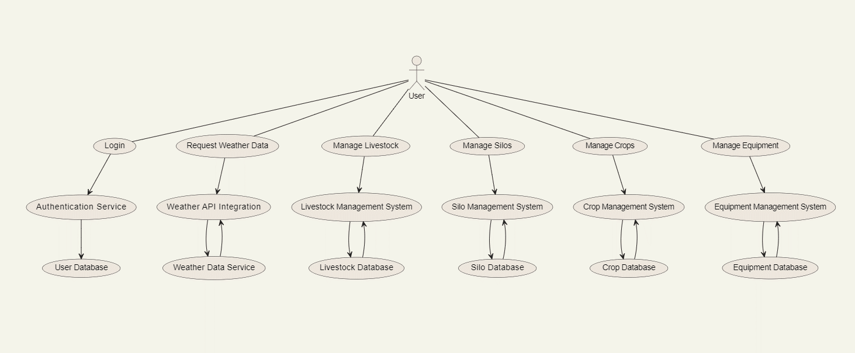
Use Case Diagram of Smart Farmer Assistance

Slide 10
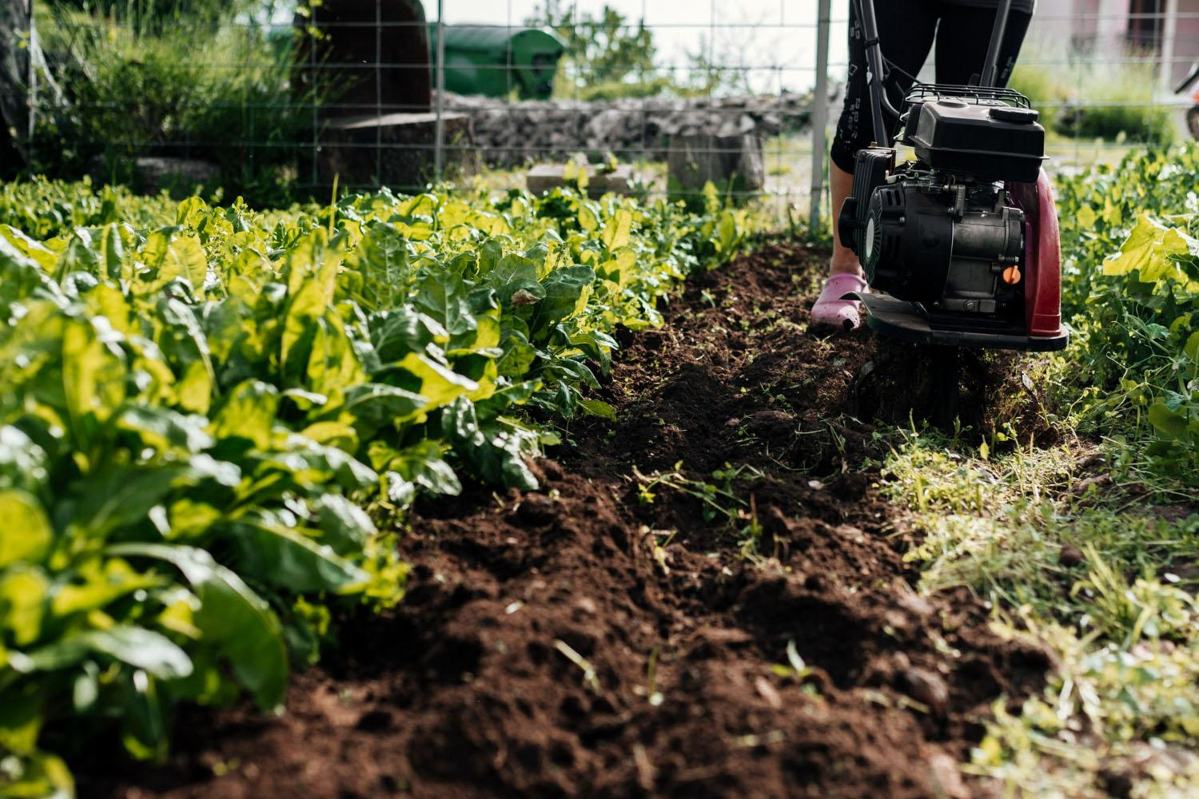
05
Outputs
Dashboard View
Crop Management Interface
Notice Management Interface
Livestock Management Interface
Agroforestry Management Interface
Silo Management Interface
Equipment Management Interface
Weather Update Interface
Email
User Approval

Slide 11
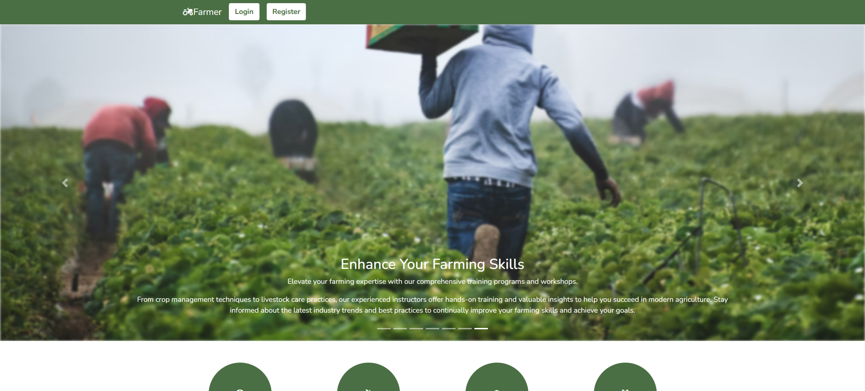
Dashboard View
Dashboard

Slide 12
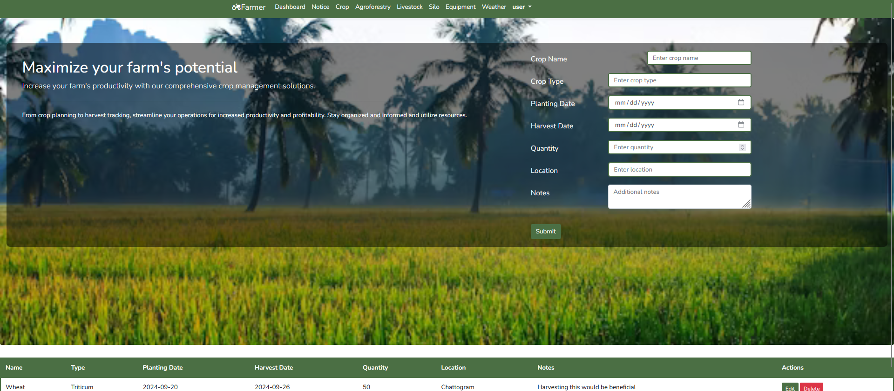
Crop Features
Crop Interface

Slide 13
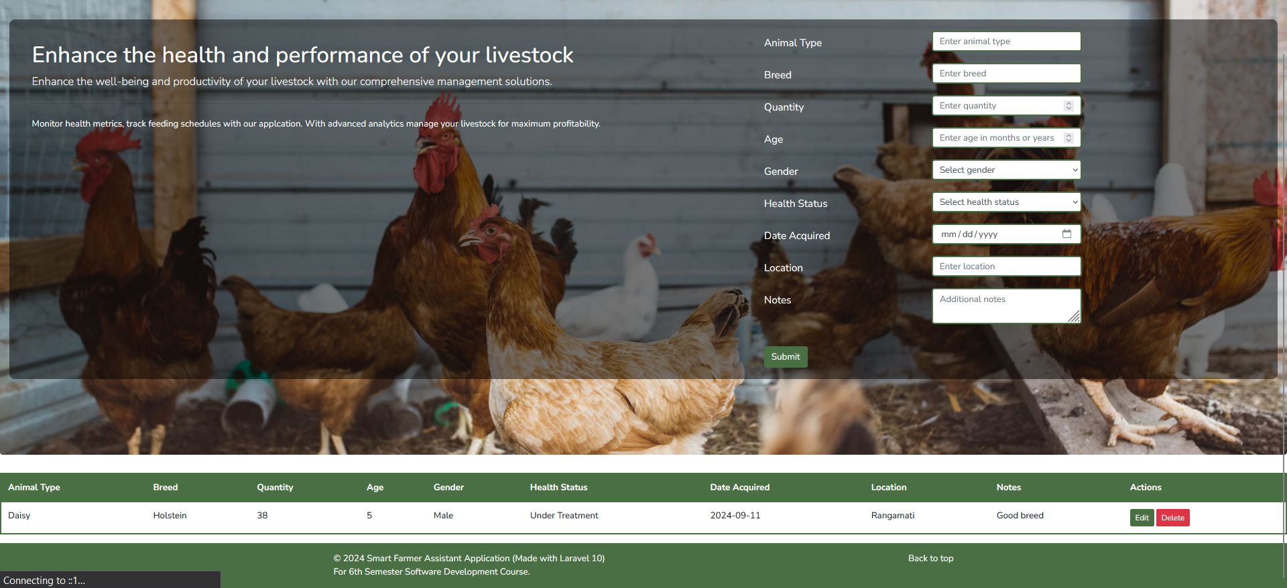
Livestock Features
Livestock Interface

Slide 14
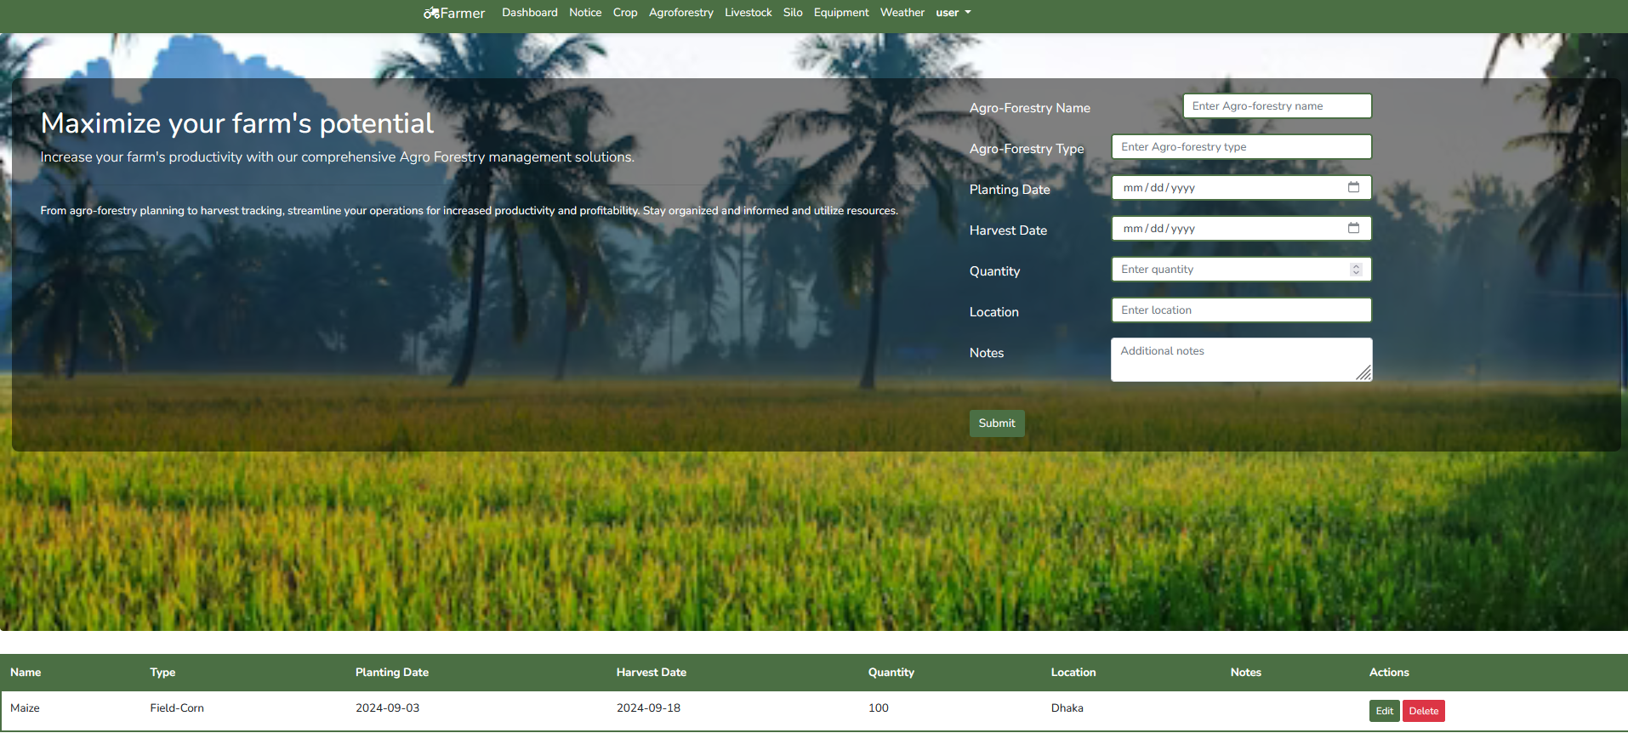
Agroforestry Features
Agroforestry Interface

Slide 15
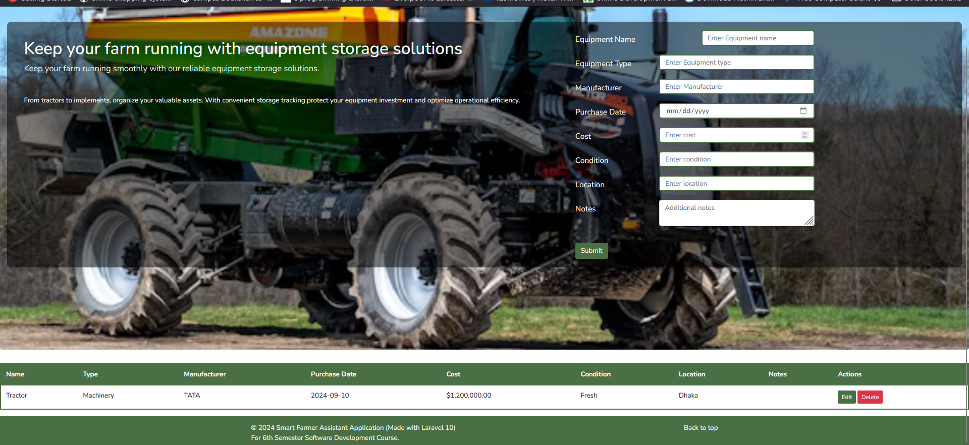
Equipment Features
Equipment Interface

Slide 16
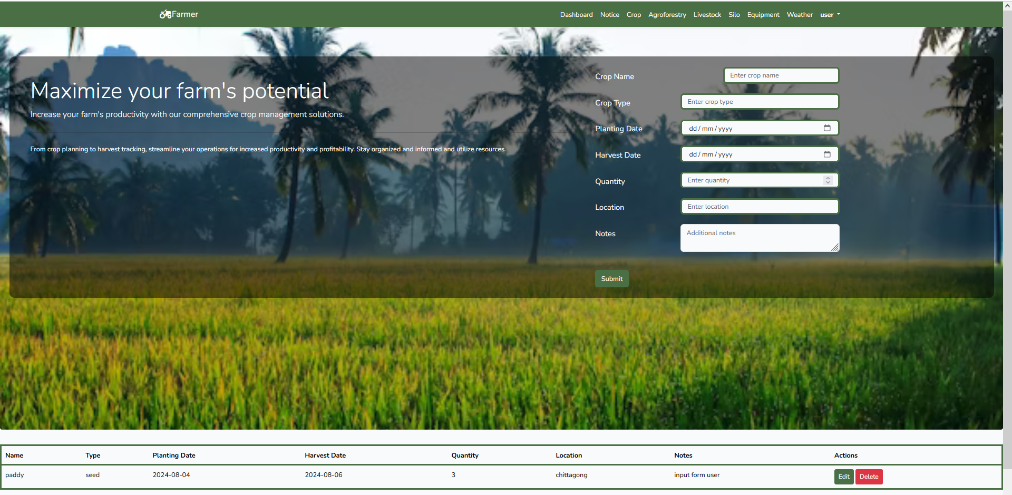
Notice Features
Notice Interface

Slide 17
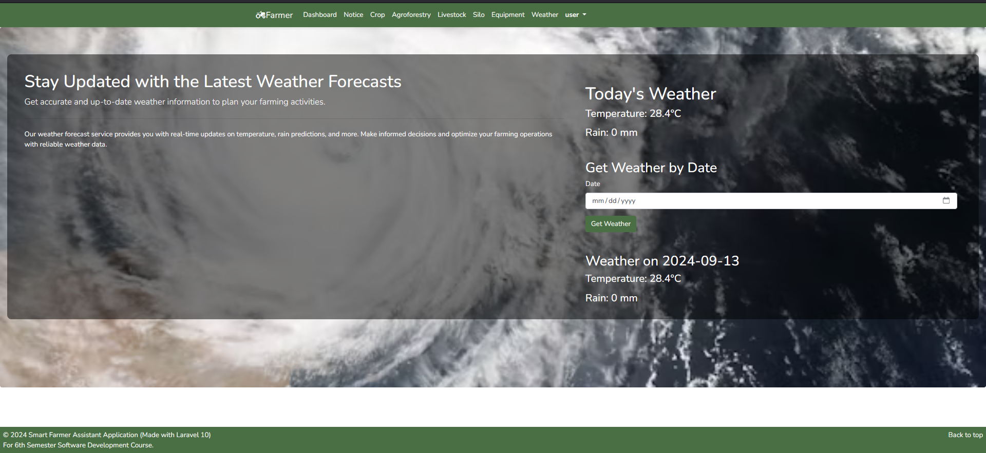
Weather Features
Weather Interface

Slide 18
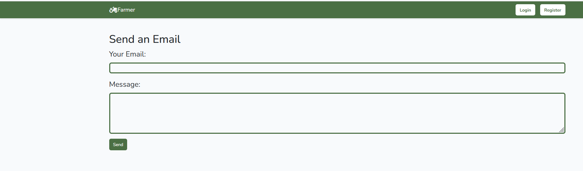
Email Features
Email Interface

Slide 19
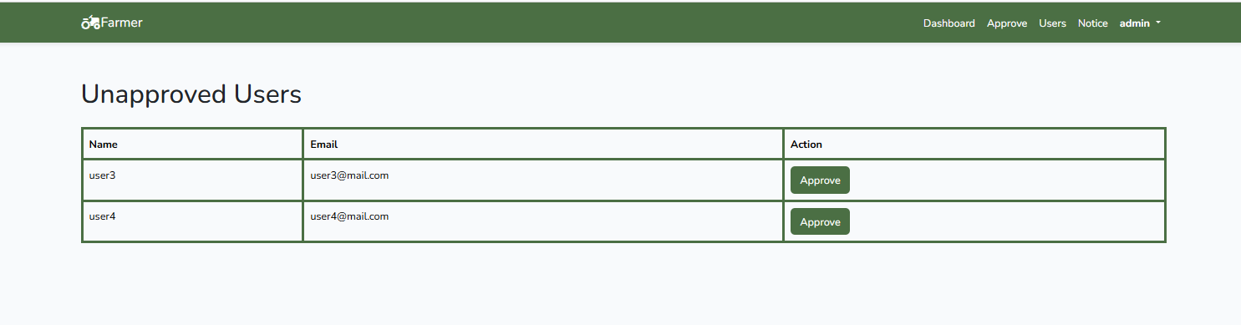
User Approval Features
Email Interface

Slide 20
06
Limitation & Future Works
Limitation
Limited Integration
Scalability Issues
User Interface Constraints

Slide 21
06
Limitation & Future Works
Future Works
Enhanced Integration
Performance Optimization
User Interface Improvements
Advanced Data Analytics

Slide 22

Conclusion
Project Achievement
Benefits
Challenges Addressed
Future Potential

Slide 23
References
Zhang, X., Li, J., & Zhao, L. (2018). "Smart Agriculture: A Review of Applications and Technologies." Journal of Agricultural Science and Technology, vol. 20, no. 3, pp. 457-478.
Singh, R., & Rathore, P. (2017). "Farm Management Information Systems: Challenges and Future Directions." Agricultural Systems, vol. 152, pp. 1-10.
Kim, H., Lee, S., & Park, C. (2019). "The Impact of Weather Data on Agricultural Decision-Making: A Comprehensive Review." International Journal of Climate Science, vol. 22, no. 4, pp. 305-319.

Slide 24
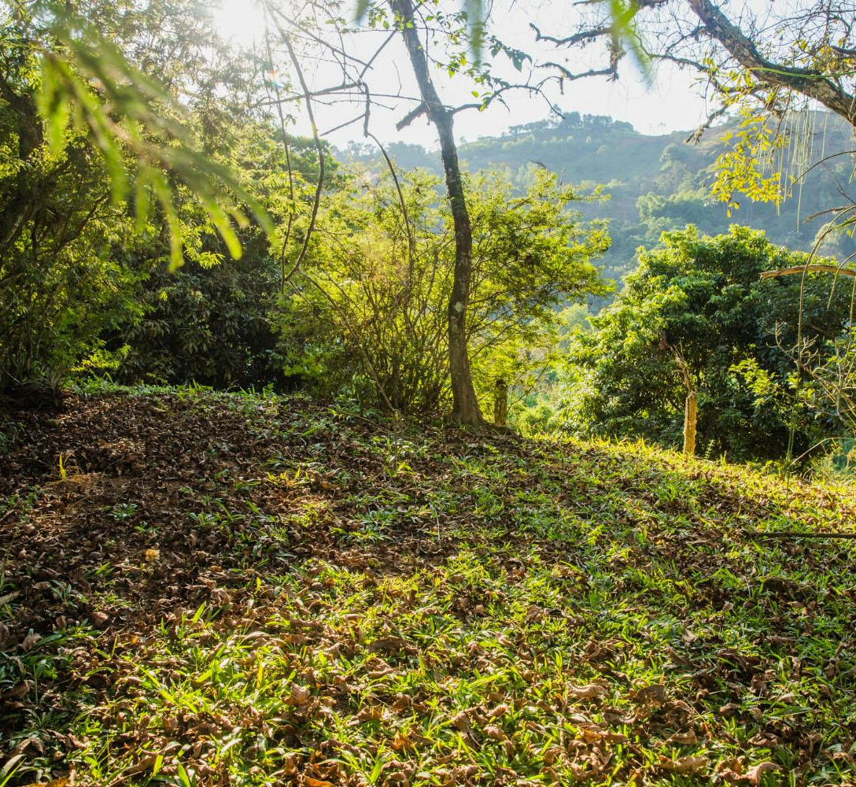
Thanks!
Do you have any questions?
hasibRana@gmail.com
+34 654 321 432
farmerassistans.com

